Slide 1
Jermyn Borough Council Meeting
09/19/2024

Slide 2
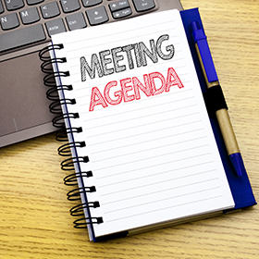
Meeting Agenda
September 19,2024
CALL TO ORDER
PLEDGE OF ALLEGIANCE
ROLL CALL
PREVIOUS MEETING MINUTES
TREASURER REPORT/BILLS PAYABLE
SECRETARY REPORT
CORRESPONDENCE
PUBLIC COMMENT
PROFESSIONAL REPORTS-POLICE, FIRE, SOLICITOR, ZONING, ENGINEER, TAX COLLECTOR, MAYOR
COMMITTEE REPORTS-SAFETY, PLANNING, FINANCE, SHADE TREE, REC, MS4, DPW
BID OPENING OLD MILL WEST RD.
EXECUTIVE SESSION
NEW BUSINESS

Slide 3
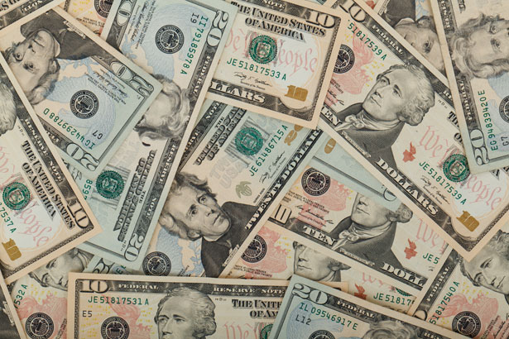
Treasurer’s report
9/19/2024
ASSETS
Checking/Savings
American Rescue Plan Fund 124,767.66
Capital Reserve - DPW 909.60
Capital Reserve - Police 6,064.82
Crime Watch Fund 222.69
General Fund - Community 132,578.22
General Fund - FNB 6,122.08
Holiday Lights Fund 300.59

Slide 4
Treasurer’s report
Investment - General Fund 1,102.36
Investment - Liquid Fuels 24,271.69
Investment - Paving Fund 1,113.84
Investment - Recycling 121.74
Investment - Refuse 173.59
Liquid Fuels - FNB 11,466.51
Petty Cash 196.50
Recreations Fund 28,616.85
Recycling - Community 4,636.39
Refuse Checking - FNB 195,900.09
Total Checking/Savings 538,565.22

Slide 5
Treasurer’s report
200000 · Accounts Payable 9,454.38
Long Term Debt 79,439.47

